Slide 1
In-Context Learning (ICL)
Sources:
* Mohit Iyyer’s advanced NLP’s slides from UMass.
* Matt Gormley slides for CMU’s Generative AI course.

Slide 2



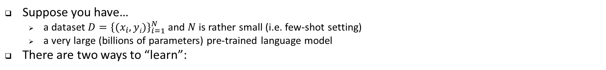
Few-shot Learning with LLMs
Suppose you have…
  a dataset $D={\left\{(x_{i}, yi)\right\}}_{i=1}^{N}$ and $N$ is rather small (i.e. few-shot setting)
  a very large (billions of parameters) pre-trained language model
There are two ways to “learn”:
Our focus today
Option A: Supervised fine-tuning
Definition: fine-tune the LLM on the training data using…
  a standard supervised objective
  backpropagation to compute gradients
  your favorite optimizer (e.g. Adam)
  Pro: fits into the standard ML recipe
  Pro: still works if N is large
  Con: backpropagation requires ~3x the memory and computation time as the forward computation
  Con: you might not have access to the model weights at all (e.g. because the model is proprietary)
Option B: In-context learning
Definition:
feed training examples to the LLM as a prompt
allow the LLM to infer patterns in the training examples during inference (i.e. decoding)
take the output of the LLM following the prompt as its prediction
Con: the prompt may be very long and Transformer LMs require O(N²) time/space where N = length of context
Pro: no backpropagation required and only one pass through the training data
Pro: does not require model weights, only API access

Slide 3

In-context learning
In-context learning was popularized in the original GPT-3 paper as a way to use language models to learn tasks given only a few examples.
On many benchmark NLP benchmarks, in-context learning is competitive with models trained with much more labeled data.
Few-shot prompting can be used as a technique to enable in-context learning where we provide demonstrations in the prompt to steer the model to better performance.

Slide 4
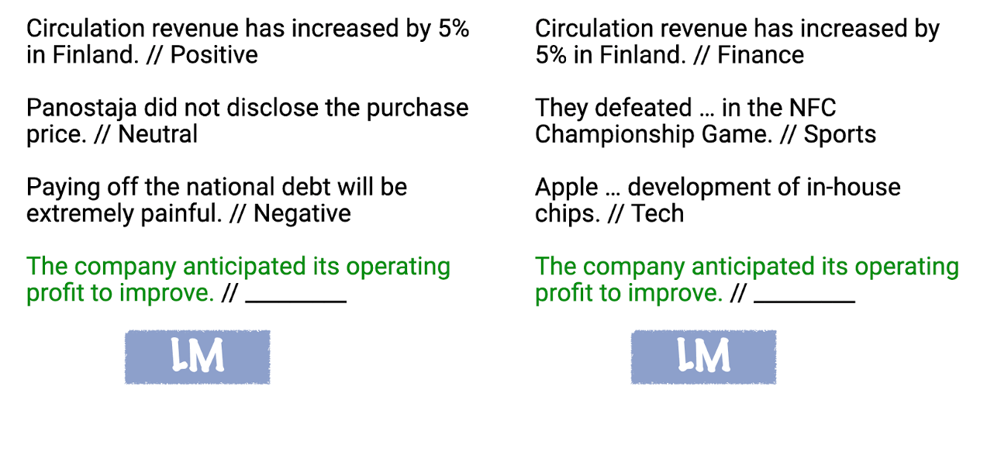
In-context learning
LLMs can solve novel downstream tasks by just conditioning on a few demonstrations of the task in its prefix.
https://ai.stanford.edu/blog/understanding-incontext/

Slide 5
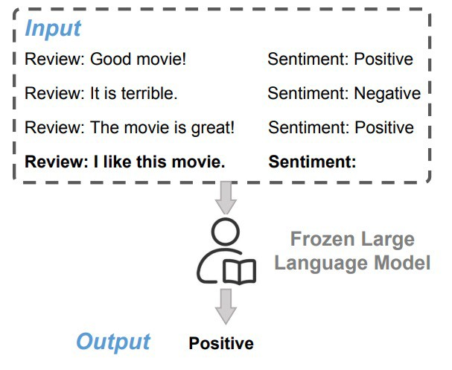
Few-shot In-context Learning
Few-shot learning can be done via in- context learning
Typically, a task description is presented first
Then a sequence of input/output pairs from a training dataset are presented in sequence
Figure from https://arxiv.org/pdf/2310.09881.pdf

Slide 6
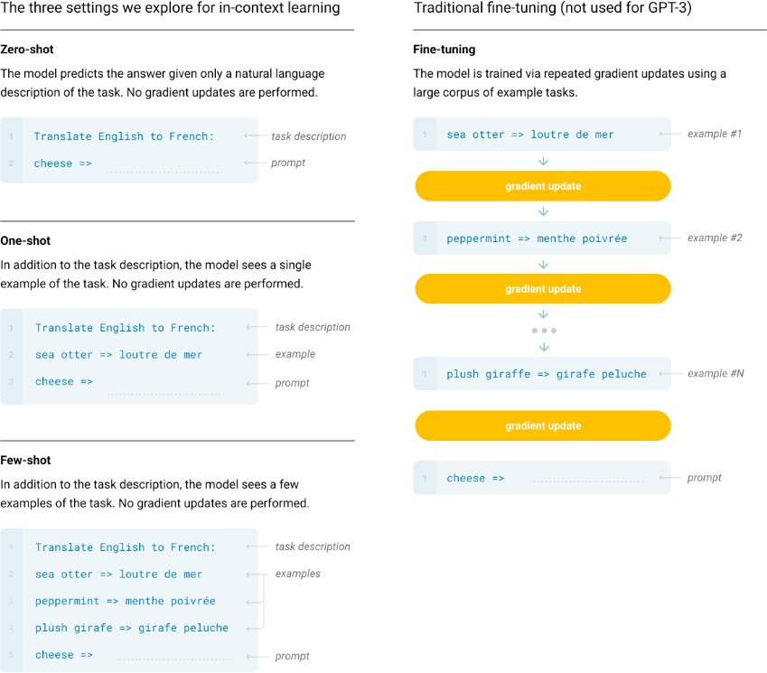
Few-shot In-context Learning (cont’d)
Few-shot learning can be done via in- context learning
Typically, a task description is presented first
Then a sequence of input/output pairs from a training dataset are presented in sequence
Figure from http://arxiv.org/abs/2005.14165

Slide 7
Why is in-context learning surprising?
Unlike conventional machine learning: No optimization of any parameters.
  This isn’t unique: Meta-learning methods have trained models that learn from examples.
The mystery is that the LM isn’t trained to learn from examples.
There’s seemingly a mismatch between pretraining (what it’s trained to do, which is next token prediction) and in-context learning (what we’re asking it to do).
This seems like magic!

Slide 8
How does this work?
Are “novel” tasks really novel? Or are they buried somewhere within the trillions of words in the Common Crawl?
If not, how can the model “learn” to solve a new task without any training (i.e., gradient updates to optimize model performance on the new task)?
In-context learning can be sensitive to…
  the order the training examples are presented
  the balance of labels (e.g. positive vs. negative)
  the number of unique labels covered
  … but is it actually?

Slide 9
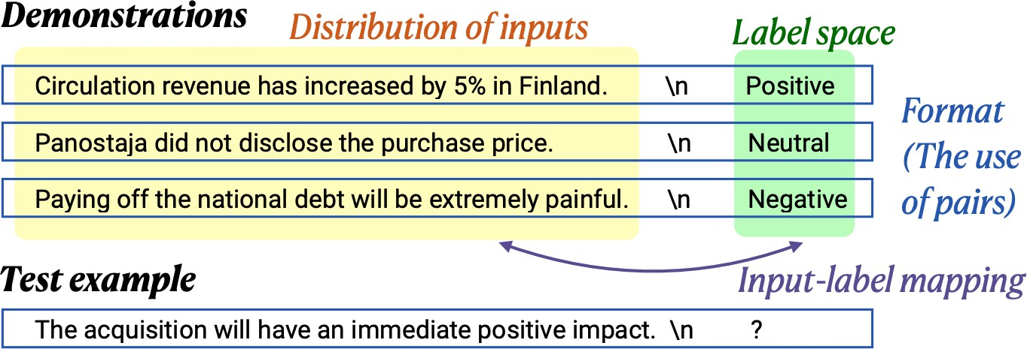
What’s in a demonstration?
Min et al., EMNLP 2022

Slide 10
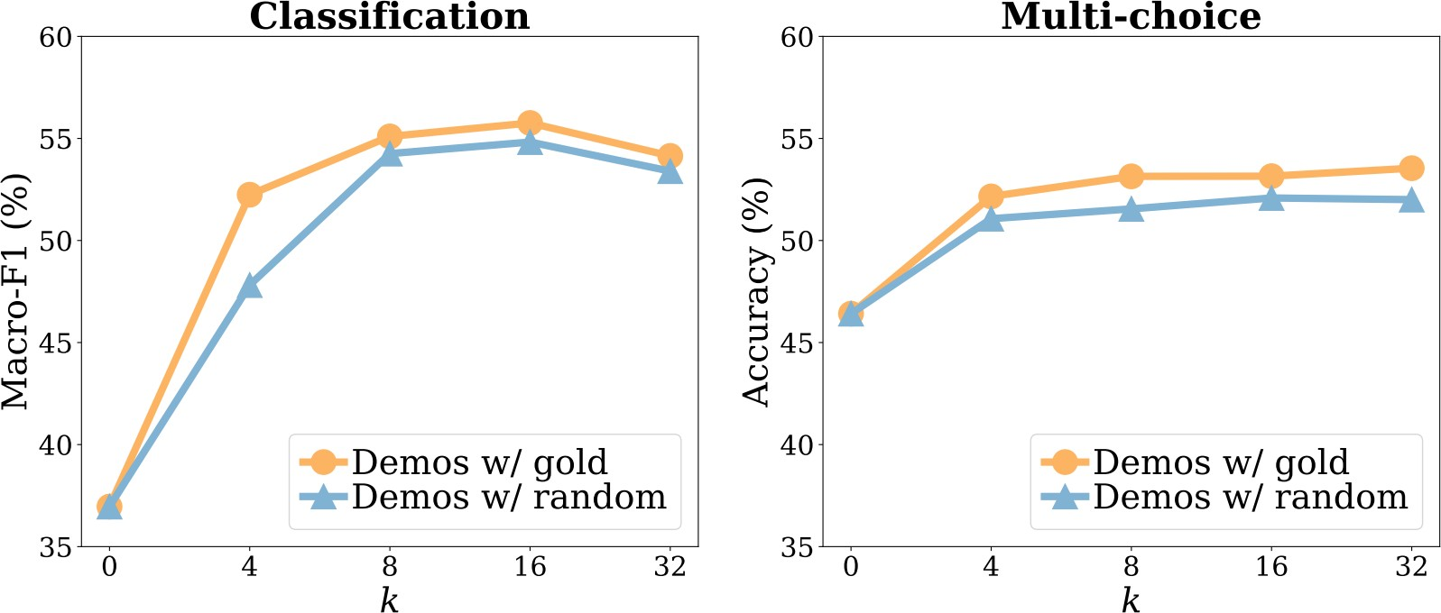
How important is input-label mapping?
Min et al., EMNLP 2022

Slide 11
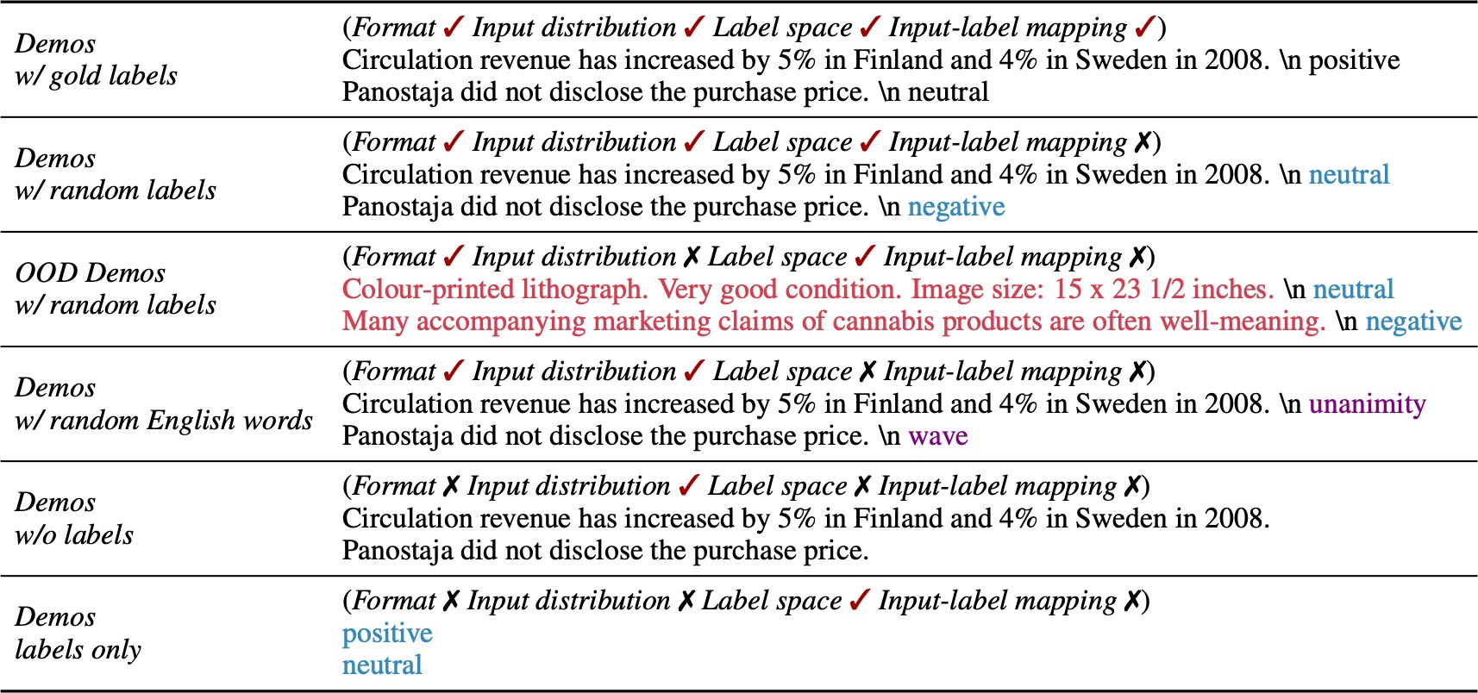
What about other aspects of the demonstrations?
Min et al., EMNLP 2022

Slide 12
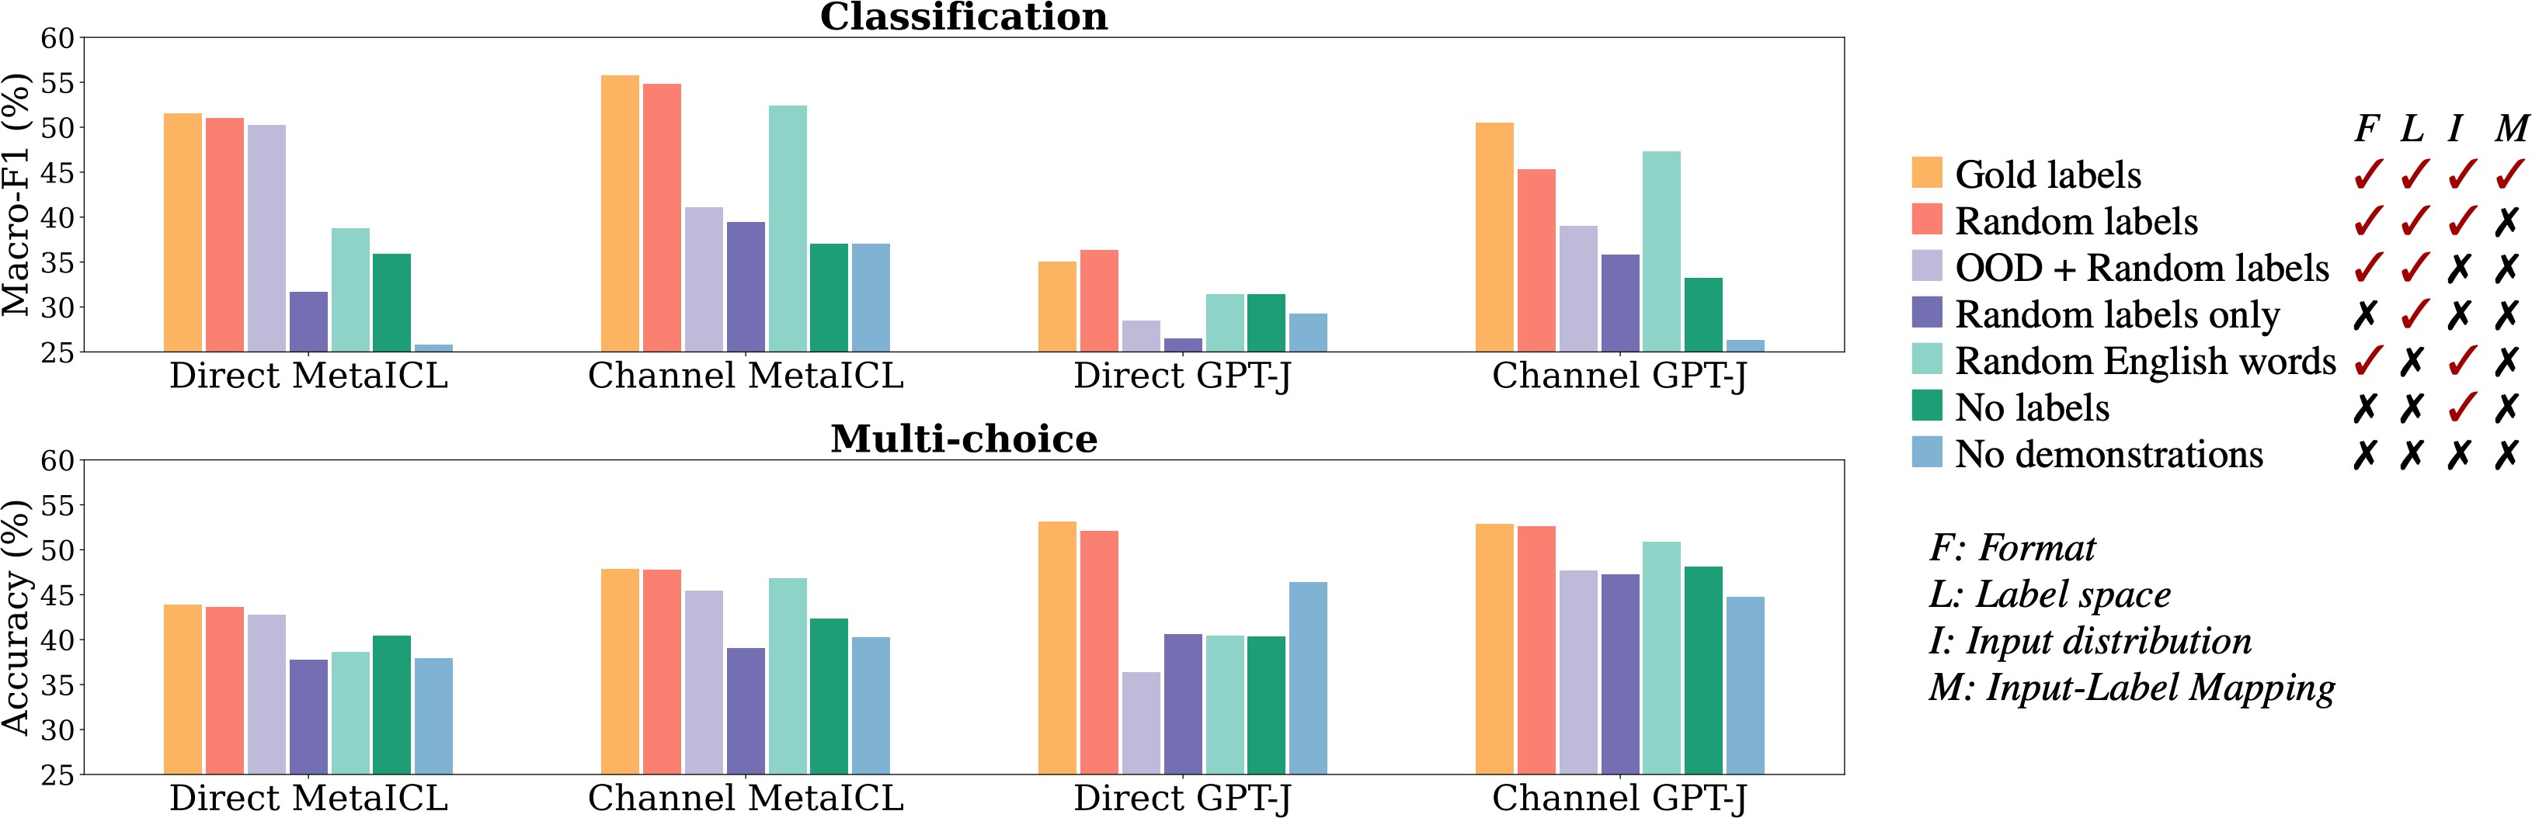
What about other aspects of the demonstrations?
Min et al., EMNLP 2022

Slide 13
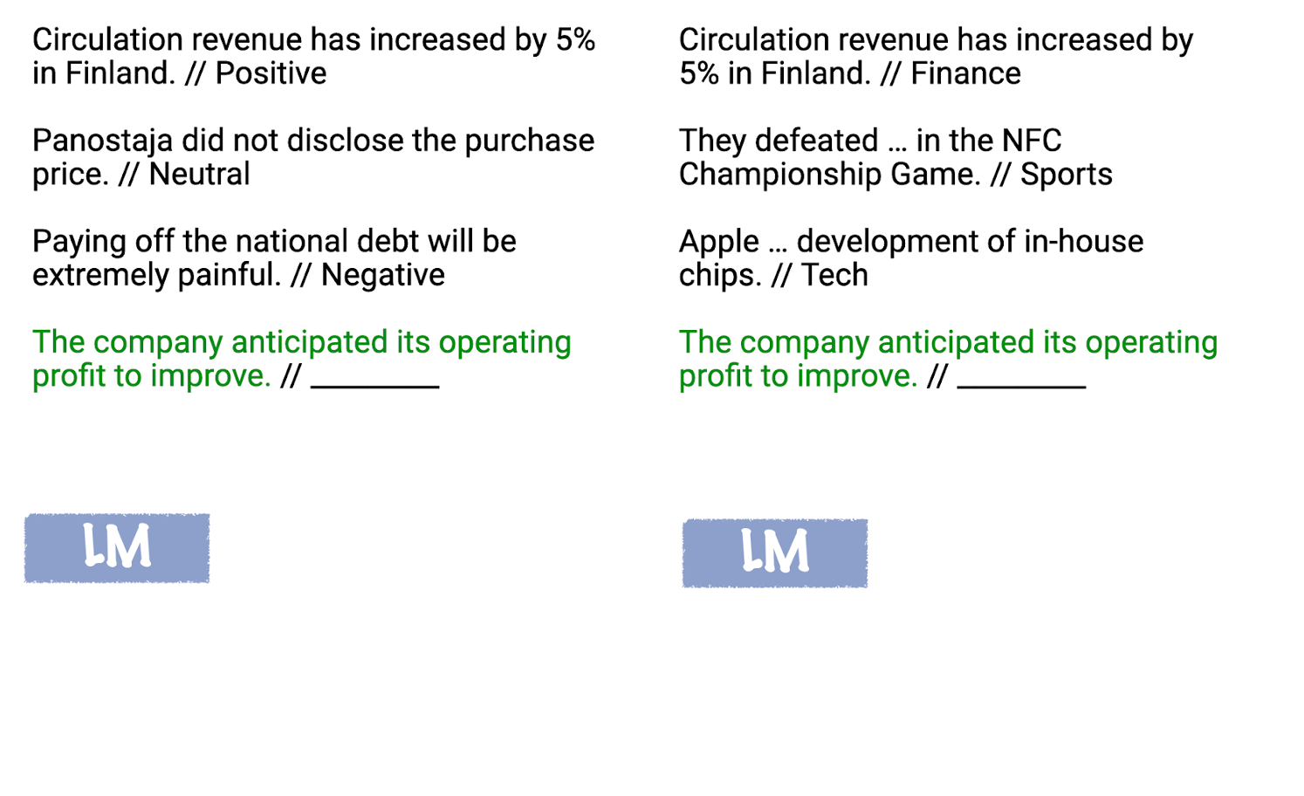
Justification
In-context learning can be thought of as “locating” latent concepts the LM has acquired from pretraining data.
All components of the prompt (inputs, outputs, formatting, and the input-output mapping) can provide information for inferring the latent concept.

Slide 14
This is a nice study, but it is also limited
Only studied simple classification tasks
The effect of these different aspects of demonstrations on generation tasks is unclear

Slide 15
Follow up work tells a diﬀerent story
Yoo et al. (2022) shows that input-label mappings matter quite significantly when using different experimental conditions and eval metrics.
Madaan and Yazdanbakhsh (2022) show that random rationales degrade chain-of-thought performance, but other modifications to the rationale (e.g., wrong equations) don’t affect it too much.

Slide 16
How does the LLM make use of (any aspect of) the demonstration?
“We investigate the hypothesis that transformer-based in-context learners implement standard learning algorithms implicitly, by encoding smaller models in their activations, and updating these implicit models as new examples appear in the context.” — Akyürek et al., ICLR 2023

Slide 17
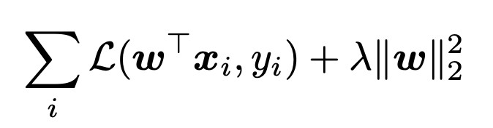

Can a Transformer do linear regression?
Akyürek et al., ICLR 2023: theoretically proved that LLMs can learn a small linear model:
The above linear regression loss has a closed form solution:
But can also be solved via gradient descent

Slide 18
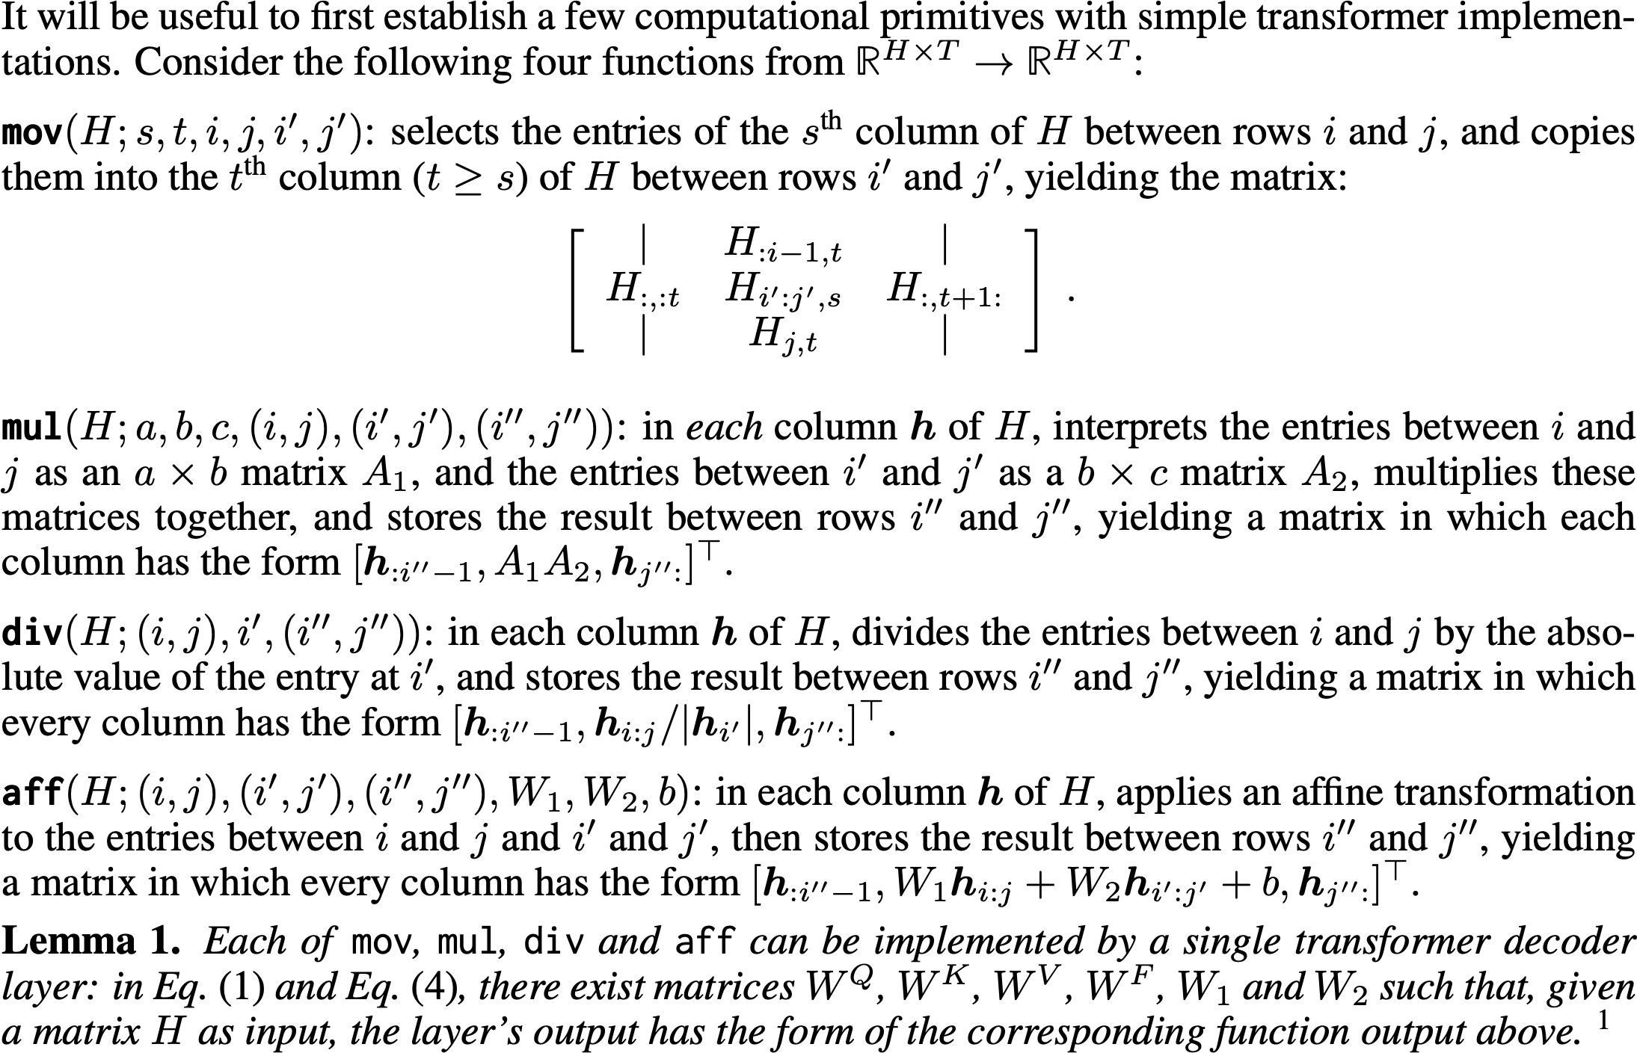
Transformers can implement some primitive operations useful for learning

Slide 19
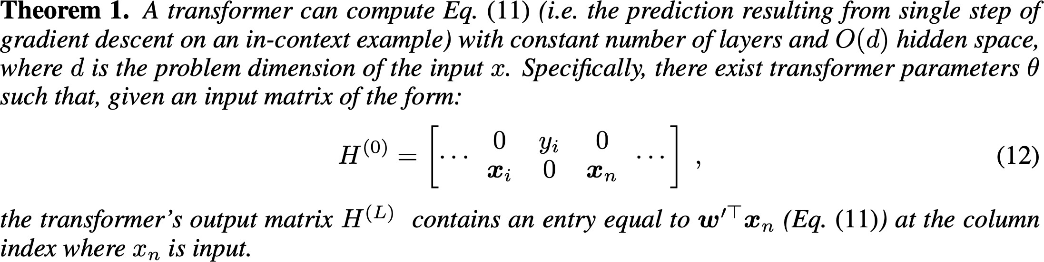
Using these primitives, they show that Transformers can implement one step of gradient descent

Slide 20
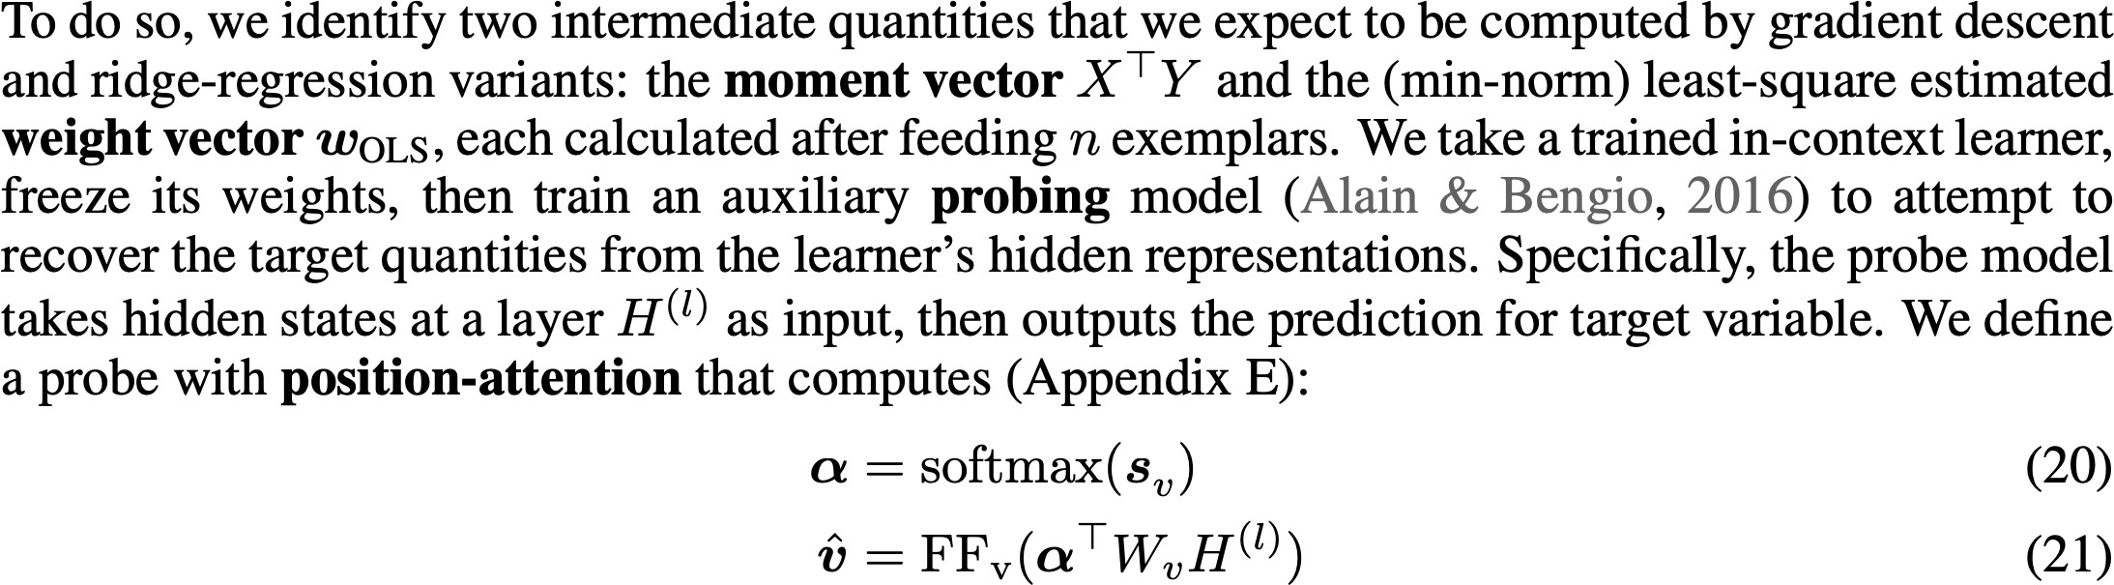
Does ICL encode meaningful intermediate quantities?
Probe networks show that Transformers encode useful intermediate computations while training the linear models.

